Slide 1
bTB transmission in cattle and badgers
How many members of a group will one infected animal go on to infect? “R₀ between groups”
 |  | FROM
 |  | Cow | Badger
TO | Cow | 0.94 | 0.049
 | Badger | 0.5 | 0.9
What does this tell us about how a disease might propagate?
What does this information tell us about the population as a whole?
How does this link to differential equation models?
Brooks-Pollock and Wood, Proc. R. Soc. B (2015) 282: 20150374

Slide 2
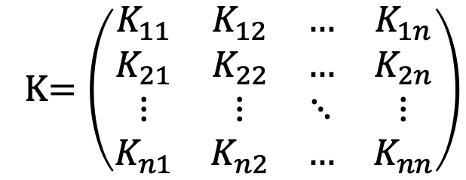
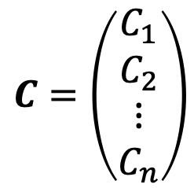
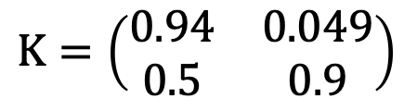
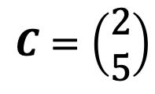
Some notation
Vector: each entry represents a trait.
Matrix: interactions between variables.
$$C=\left(\begin{matrix}C_{1} \\ C_{2} \\ \begin{aligned}⋮ \\ C_{n}\end{aligned}\end{matrix}\right)$$
K$=\left(\begin{matrix}K_{11} & K_{12} & … & K_{1n} \\ K_{21} & K_{22} & … & K_{2n} \\ ⋮ & ⋮ & ⋱ & ⋮ \\ K_{n1} & K_{n2} & … & K_{nn}\end{matrix}\right)$
Infected populations: 2 cows, 5 badgers
 |  | FROM
 |  | Cow | Badger
TO | Cow | 0.94 | 0.049
 | Badger | 0.5 | 0.9
Entry 1: cow
$$C=\left(\begin{matrix}2 \\ 5\end{matrix}\right)$$
$$K=\left(\begin{matrix}0.94 & 0.049 \\ 0.5 & 0.9\end{matrix}\right)$$
Entry 2: badger

Slide 3
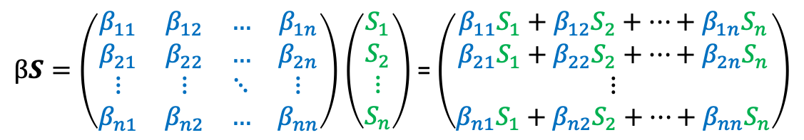
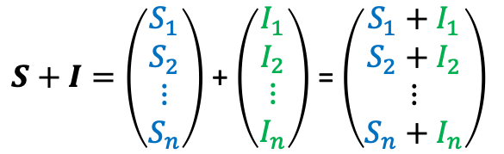
Vector and matrix operations
Add/subtract element-by-element
$S+I=\left(\begin{matrix}S_{1} \\ S_{2} \\ \begin{aligned}⋮ \\ S_{n}\end{aligned}\end{matrix}\right)$ + $\left(\begin{matrix}I_{1} \\ I_{2} \\ \begin{aligned}⋮ \\ I_{n}\end{aligned}\end{matrix}\right)$ = $\left(\begin{matrix}S_{1}+I_{1} \\ S_{2}+I_{2} \\ \begin{aligned}⋮ \\ S_{n}+I_{n}\end{aligned}\end{matrix}\right)$
Multiplication more complex…
$βS=\left(\begin{matrix}β_{11} & β_{12} & … & β_{1n} \\ β_{21} & β_{22} & … & β_{2n} \\ ⋮ & ⋮ & ⋱ & ⋮ \\ β_{n1} & β_{n2} & … & β_{nn}\end{matrix}\right)$ $\left(\begin{matrix}S_{1} \\ S_{2} \\ \begin{aligned}⋮ \\ S_{n}\end{aligned}\end{matrix}\right)$ = $\left(\begin{matrix}{β_{11}S}_{1}+β_{12}S_{2}+…+β_{1n}S_{n} \\ {β_{21}S}_{1}+β_{22}S_{2}+…+β_{2n}S_{n} \\ \begin{aligned}⋮ \\ {β_{n1}S}_{1}+β_{n2}S_{2}+…+β_{nn}S_{n}\end{aligned}\end{matrix}\right)$

Slide 4
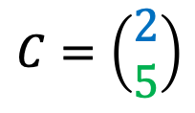

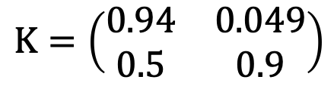
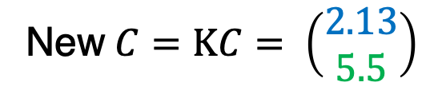
Next generation matrix
$Kij$: expected no of infections in state i from individual in state j
Multiply our vector of infected populations by K to get next generation
$$K=\left(\begin{matrix}0.94 & 0.049 \\ 0.5 & 0.9\end{matrix}\right)$$
$$C=\left(\begin{matrix}2 \\ 5\end{matrix}\right)$$
New $C=KC= \left(\begin{matrix}2.13 \\ 5.5\end{matrix}\right)$
Cows infected: 0.94 × 2 cows + 0.049 × 5 badgers ≈ 2.13 new cows
Badgers infected: 0.5 × 2 cows + 0.9 × 5 badgers ≈ 5.5 new badgers

Slide 5
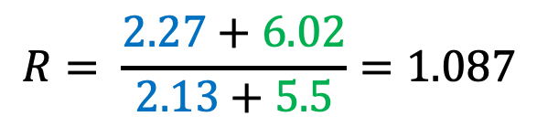
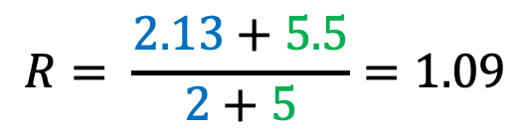
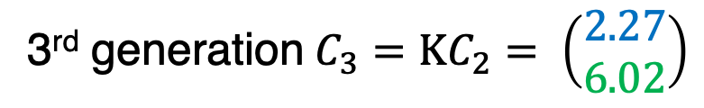
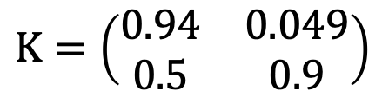
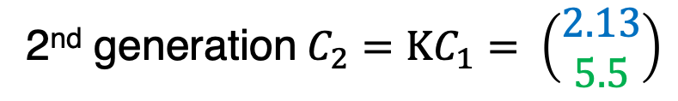
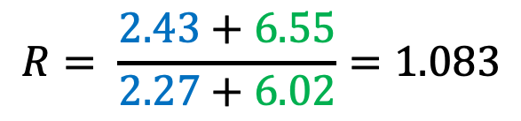
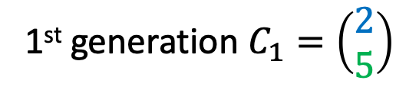
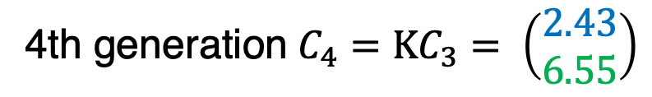
Next generation matrix
$$K=\left(\begin{matrix}0.94 & 0.049 \\ 0.5 & 0.9\end{matrix}\right)$$
1st generation$C_{1}=\left(\begin{matrix}2 \\ 5\end{matrix}\right)$
2nd generation $C_{2}=KC_{1}= \left(\begin{matrix}2.13 \\ 5.5\end{matrix}\right)$
Average no infected per individual = $\frac{\text{new} \text{infected} \text{cows}\text{ + }\text{new} \text{infected} \text{badgers}}{\text{previous} \text{infected} \text{cows}\text{ + }\text{previous} \text{infected} \text{badgers}}$
$$R= \frac{2.13+5.5}{2+5}=1.09$$
3rd generation $C_{3}=KC_{2}= \left(\begin{matrix}2.27 \\ 6.02\end{matrix}\right)$
$$R= \frac{2.27+6.02}{2.13+5.5}=1.087$$
4th generation $C_{4}=KC_{3}= \left(\begin{matrix}2.43 \\ 6.55\end{matrix}\right)$
$$R= \frac{2.43+6.55}{2.27+6.02}=1.083$$
Etc…

Slide 6
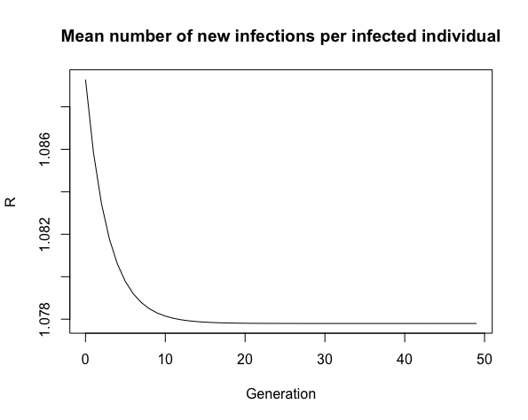
Finding R₀
Find average number of new infections per infected individual, R
Repeat process for several generations
Tends towards one value
This is R₀!
Notes:
Note in this system we’re going in with an ‘R0-like’ assumption; the next generation matrix is built assuming there will always be an unlimited susceptible population.
We have convergence since the proportions of the two populations also need to settle
Whether it increases/decreases depends on ICs

Slide 7

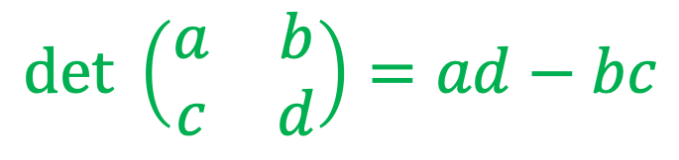
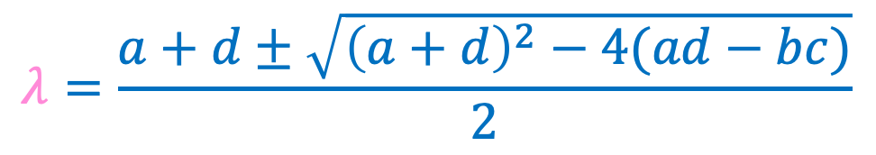
Matrix determinants and eigenvalues
Determinant: single number associated with matrix with many uses (scaling, inverting matrix, solving equations)
Eigenvalues: set of numbers also summarizing matrix properties
$$det \left(\begin{matrix}a & b \\ c & d\end{matrix}\right)=ad−bc$$
$$det\left(\begin{matrix}a−λ & b \\ c & d−λ\end{matrix}\right)=0$$ $$\left(a−λ\right)\left(d−λ\right)−bc=0$$ $$λ^{2}−\left(a+d\right)λ+ad−bc=0$$
$$λ=\frac{a+d±\sqrt{{\left(a+d\right)}^{2}−4(ad−bc)}}{2}$$

Slide 8
Finding R₀
Is there an easier way to do this?
Yes! This kind of matrix multiplication always gives us the largest eigenvalue.
Notes:
Note in this system we’re going in with an ‘R0-like’ assumption; the next generation matrix is built assuming there will always be an unlimited susceptible population.
We have convergence since the proportions of the two populations also need to settle
Whether it increases/decreases depends on ICs

Slide 9
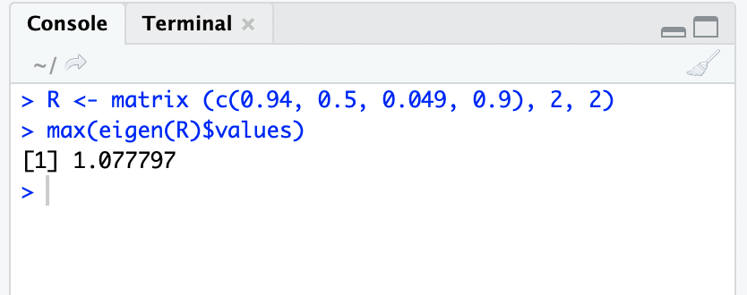
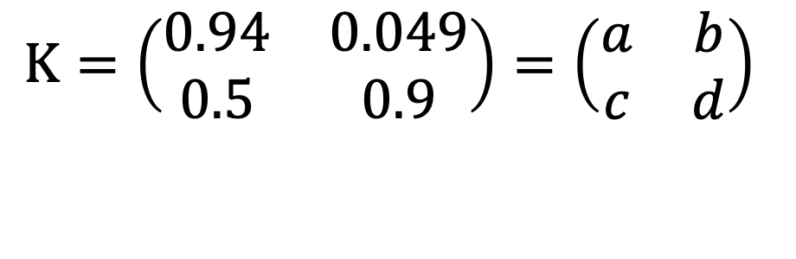

Finding R₀
$$K=\left(\begin{matrix}0.94 & 0.049 \\ 0.5 & 0.9\end{matrix}\right)=\left(\begin{matrix}a & b \\ c & d\end{matrix}\right)$$
$R_{0}=\frac{a+d+\sqrt{{\left(a+d\right)}^{2}−4(ad−bc)}}{2}$ = $\frac{0.94+0.9+\sqrt{{\left(0.94+0.9\right)}^{2}−4(0.94×0.9−0.049×0.5)}}{2}≈1.08$
Is there an even easier way to do this?
Get a computer to do it for you!
$$R_{0}≈1.08$$

Slide 10
Theoretical approach

Slide 11
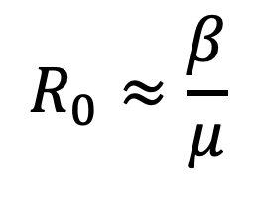
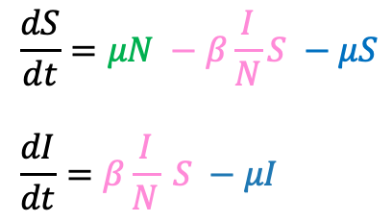
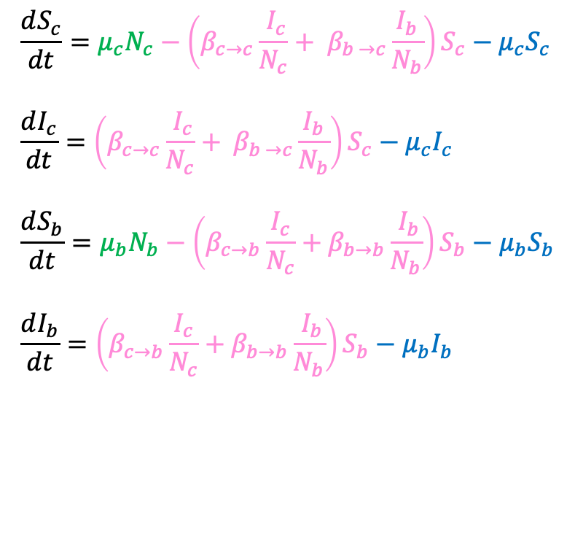
Structured model: example
Example: 2 species model of bTB transmission in cattle and badgers
$$\frac{dS_{c}}{dt}=μ_{c}N_{c}−\left(β_{c→c}\frac{{ I}_{c}}{N_{c}}+ β_{b →c}\frac{I_{b}}{N_{b}}\right)S_{c}−μ_{c}S_{c} \\ \frac{dI_{c}}{dt}=\left(β_{c→c}\frac{{ I}_{c}}{N_{c}}+ β_{b →c}\frac{I_{b}}{N_{b}}\right)S_{c}−μ_{c}I_{c} \\ \frac{dS_{b}}{dt}=μ_{b}N_{b}−\left(β_{c→b}\frac{I_{c}}{N_{c}}+β_{b→b}\frac{{ I}_{b}}{N_{b}}\right)S_{b}−μ_{b}S_{b} \\ \frac{dI_{b}}{dt}=\left(β_{c→b}\frac{I_{c}}{N_{c}}+β_{b→b}\frac{{ I}_{b}}{N_{b}}\right)S_{b}−μ_{b}I_{b}$$
Birth
Death
$$\frac{dS}{dt}=μN −β\frac{I}{N}S −μS \\ \frac{dI}{dt}=β\frac{I}{N} S −μI$$
$$R_{0}≈\frac{β}{μ}$$
Infection

Slide 12
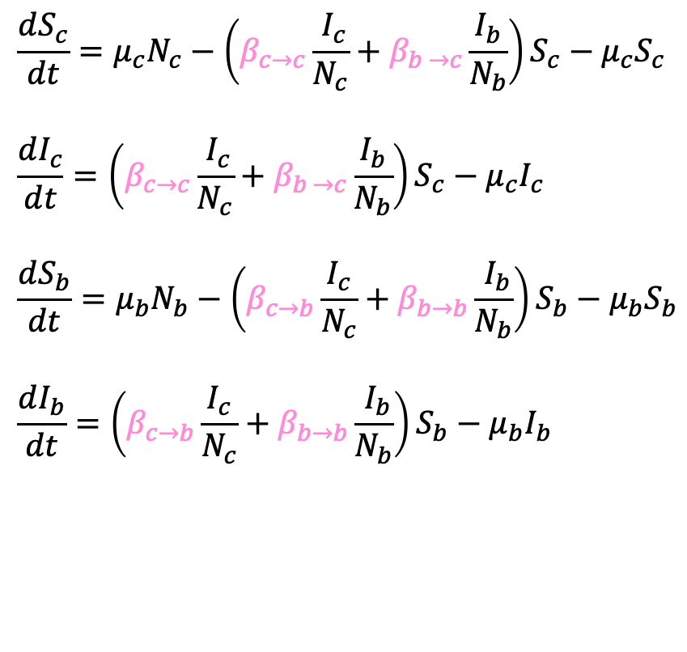
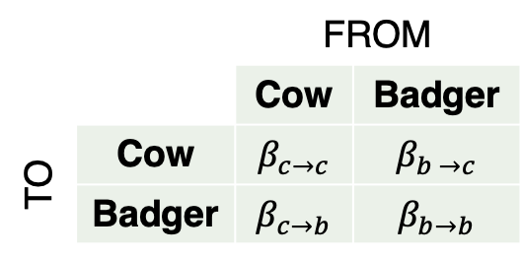
Transmission rates
$$\frac{dS_{c}}{dt}=μ_{c}N_{c}−\left(β_{c→c}\frac{{ I}_{c}}{N_{c}}+β_{b →c}\frac{I_{b}}{N_{b}}\right)S_{c}−μ_{c}S_{c} \\ \frac{dI_{c}}{dt}=\left(β_{c→c}\frac{{ I}_{c}}{N_{c}}+β_{b →c}\frac{I_{b}}{N_{b}}\right)S_{c}−μ_{c}I_{c} \\ \frac{dS_{b}}{dt}=μ_{b}N_{b}−\left(β_{c→b}\frac{I_{c}}{N_{c}}+β_{b→b}\frac{{ I}_{b}}{N_{b}}\right)S_{b}−μ_{b}S_{b} \\ \frac{dI_{b}}{dt}=\left(β_{c→b}\frac{I_{c}}{N_{c}}+β_{b→b}\frac{{ I}_{b}}{N_{b}}\right)S_{b}−μ_{b}I_{b}$$
 |  | FROM
 |  | Cow | Badger
TO | Cow | $$β_{c→c}$$ | $$β_{b →c}$$
 | Badger | $$β_{c→b}$$ | $$β_{b→b}$$

Slide 13
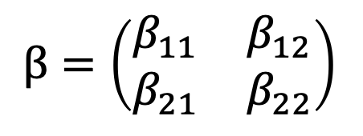

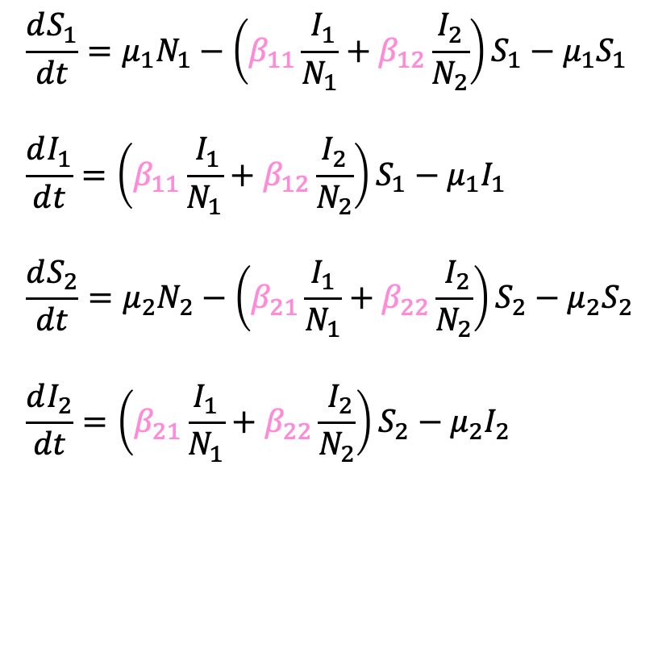
Transmission rates
$$\frac{dS_{1}}{dt}=μ_{1}N_{1}−\left(β_{11}\frac{{ I}_{1}}{N_{1}}+β_{12}\frac{I_{2}}{N_{2}}\right)S_{1}−μ_{1}S_{1} \\ \frac{dI_{1}}{dt}=\left(β_{11}\frac{{ I}_{1}}{N_{1}}+β_{12}\frac{I_{2}}{N_{2}}\right)S_{1}−μ_{1}I_{1} \\ \frac{dS_{2}}{dt}=μ_{2}N_{2}−\left(β_{21}\frac{I_{1}}{N_{1}}+β_{22}\frac{{ I}_{2}}{N_{2}}\right)S_{2}−μ_{2}S_{2} \\ \frac{dI_{2}}{dt}=\left(β_{21}\frac{I_{1}}{N_{1}}+β_{22}\frac{{ I}_{2}}{N_{2}}\right)S_{2}−μ_{2}I_{2}$$
 |  | FROM
 |  | Cow | Badger
TO | Cow | $$β_{c→c}$$ | $$β_{b →c}$$
 | Badger | $$β_{c→b}$$ | $$β_{b→b}$$
$β=\left(\begin{matrix}β_{11} & β_{12} \\ β_{21} & β_{22}\end{matrix}\right)$

Slide 14

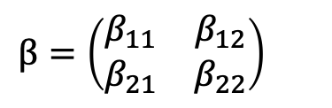


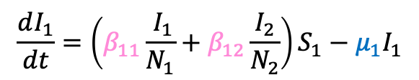
Back to the Next Generation Matrix
$K_{ij}$: expected no of infections in state i from individual in state j
Rate of transmission × time spent infectious
Rate of transmission
Eg. ${ β}_{11}×\frac{1}{μ_{1}}$
$K=\left(\begin{matrix}\frac{β_{11}}{μ_{1}} & \frac{β_{12}}{μ_{2}} \\ \frac{β_{21}}{μ_{1}} & \frac{β_{22}}{μ_{2}}\end{matrix}\right)$
Time spent infectious
$β=\left(\begin{matrix}β_{11} & β_{12} \\ β_{21} & β_{22}\end{matrix}\right)$
$$\frac{dI_{1}}{dt}=\left(β_{11}\frac{{ I}_{1}}{N_{1}}+β_{12}\frac{I_{2}}{N_{2}}\right)S_{1}−μ_{1}I_{1}$$
New infected cows added
Infected cows removed
For a more mathematical treatment, see: Diekmann et al, J. R. Soc. Interface (2010) 7, 873–885
Notes:
NB the Brooks-Pollock & Wood paper has an extra term in the model – they stick in a removal term, rate gamma, to account for removal of infected cattle by test-and-slaughter, and artificially increase birth rate by gamma to keep populations at fixed sizes.

Slide 15
In conclusion:
Structured models reflect variation within population
We can summarise transmission between groups using the next generation matrix
R₀ for the whole population is its maximum eigenvalue
We can link next generation matrices and parameters in a differential equation model

